Slide 1
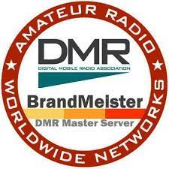
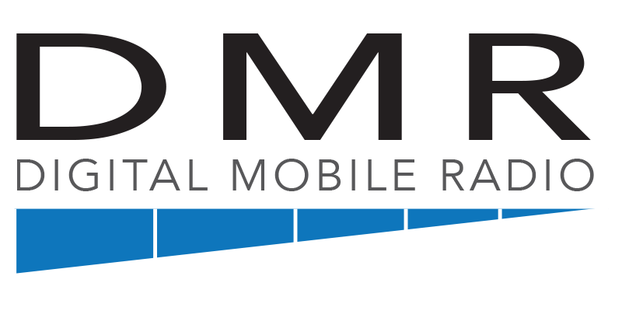
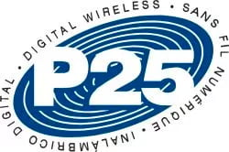
Various Amateur Digital Voice Mode Radios and Supporting Amateur Infrastructure with Internet Connectivity

Slide 2
Types of 2m and 70 cm Mobile, Portable and Base Radios Owned and Operated by Radio Amateurs
FM only, single or dual band with or without DTMF signaling.
D-Star Digital (typically Icom) also with FM modulation.
Yaesu System Fusion Digital also with FM modulation.
DMR Digital also with FM modulation.
Also Kenwood & ICOM, NXDN and Surplus P25 digital radios.
Some Icom and Yaesu Multi-Mode VHF and UHF radios also incorporate digital voice mode capability such as the ICOM IC-705 & IC-7100 (D-Star) and Yaesu FT 911A (YSF digital).
** Note that all the Digital modulation formats are unique and *not* capable of communicating directly “OVER-THE-AIR” with each other. An Icom D-Star radio transmission can only communicate directly with another D-Star radio, the same for a Yaesu Fusion radio and the same for a DMR radio. **

Slide 3
Common types of Amateur Digital Voice Radios
D-Star – is available in ICOM and some Kenwood portable radios. Also it has been available as an option in newer Flex HF transceivers. D-Star uses a unique AMBE vocoder. It was designed exclusively for the Amateur Radio Service. D-Star users must be registered on the US Trust system to access certain registered repeaters and reflectors. D-Star user call-sign identification is transmitted on every D-Star radio transmission. It requires sync’ing at the beginning of the transmission or the transmission is lost. Emission BW is 6.25 kHz using GMSK modulation.
Yaesu System Fusion (YSF) is Yaesu’s competition to ICOM D-Star. Like D-Star it was designed exclusively for the Amateur Radio Service. It uses an AMBE+2 vocoder. It’s over-the-air framing structure and vocoder are different from D-Star and therefore the two modes are incompatible directly over-the-air. Yaesu System Fusion in digital voice mode have an emission BW of 9.36 kHz using C4FM modulation.
DMR (Digital Mobile Radio) conforms to an open ETSI standard and it was designed for the Private “Land-Mobile” service. ID and addressing of DMR in the amateur service is implemented with a 7 digital ID code obtained with registration from: < Radioid.net>. DMR is also unique because it use 2 slot TDMA (time Division Multiple Access). Like YSF radios, DMR radios use the same AMBE+2 vocoder which makes transcoding to YSF and vice versa relatively easy. DMR radios occupy an emission BW of 7.6 kHz using 4 level FSK modulation.

Slide 4
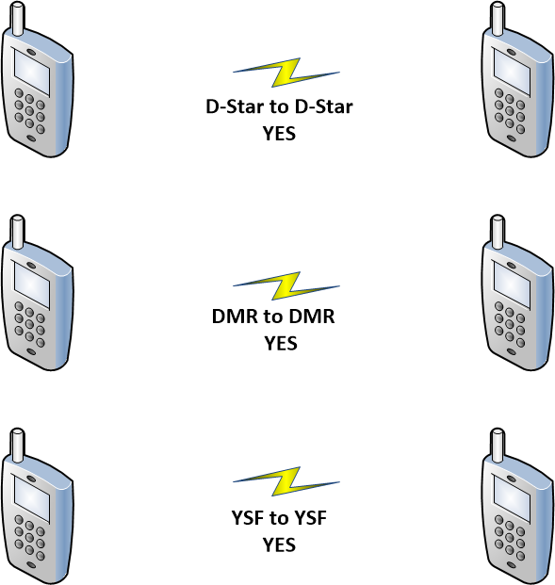
In Digital Voice Mode Only Radios of Like-Kind are able to Communicate Directly with each other. They do however remain compatible with each other in FM

Slide 5
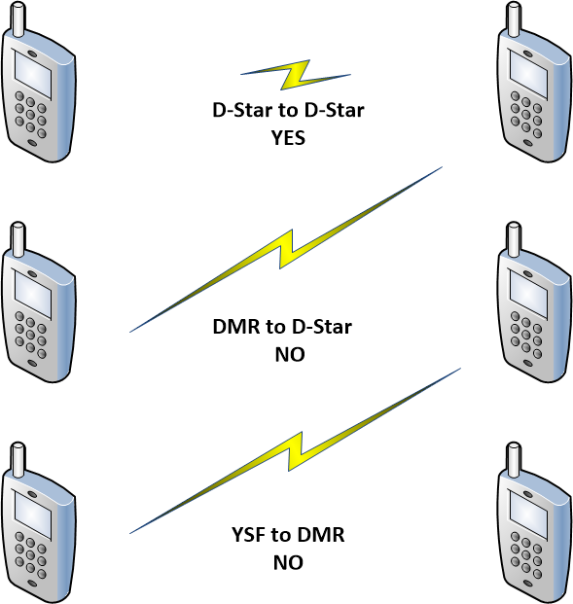

Slide 6
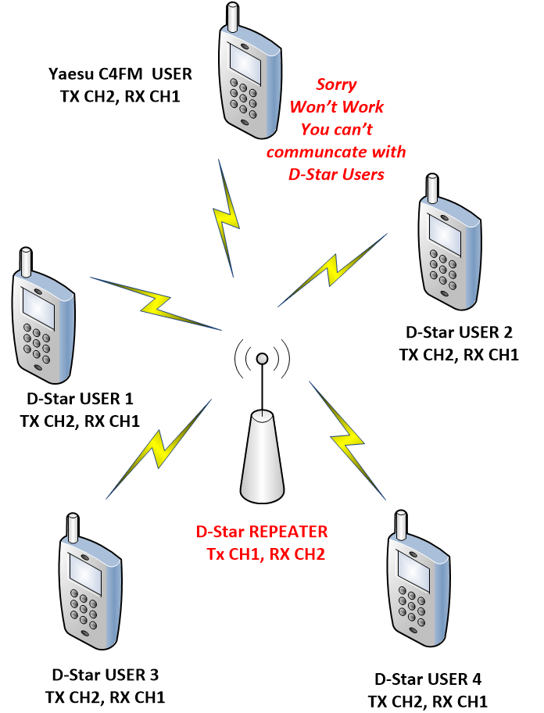
Most OEM digital capable repeaters on a given pair of frequencies at a site are capable of “repeating” on one digital mode only at a time.
However, using Pi-Star working on a Raspberry Pi and associated hardware as a repeater controller an amateur repeater can now support several digital modes such as D-Star, YSF and DMR, but only one at a time
That said, such repeaters can only repeat out the same digital mode as it receives on a given pair of frequencies.
More on this later.

Slide 7
However
Through a Multi-protocol Reflector, it is possible
radios with different digital protocols like D-Star, DMR and Fusion can all talk together on a common voice channel.
Save this thought.

Slide 8
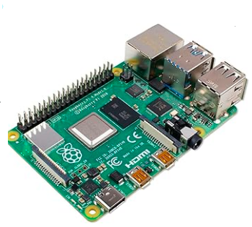
What is a Reflector?
The term Reflector refers to a server computer with a live connection on the internet operating specially crafted communications software. The typical reflector produces a “conference” call for all that simultaneously connect to it. Most amateur reflector software is open source and free to distribute and use. Clients (Users) of the Reflectors using their radios (or otherwise) are connected to reflectors by way of local amateur radio repeaters or personal “Hot Spots” also requiring a live connection to the Internet.
Home Based PC Linux Server or Raspberry Pi with port forwarding and using a Domain Name Service on the open Internet
A Reflector can be installed as a “VM” in rented space in a Cloud based Server Farm
OR
EVEN
OR

Slide 9
D-Star Exclusive Reflectors --
An evolution of capability and administration.
REFnnn – This is Dplus closed reflector system. It uses first generation proprietary software source and interconnects many world-wide repeaters. It uses the US Trust as their source for registered users.
DCSnnn – This is the Digital Call Server reflector system, again a closed system that run on ircDDB software and do not require users to register (although the reflectors themselves are registered).
XRFnnn – These reflectors run on the open source DExtra software which have their own “trust” servers. XRF reflectors also handle REF and DCS linking protocols

Slide 10
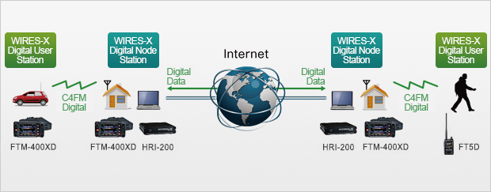
Yaesu System Fusion
In the Yaesu world of Internet C4FM digital radio connectivity, there is the Yaesu Wires X server system that manages node ID and “Rooms” (conferences of communications) for Yaesu System Fusion radio users. It is proprietary to Yaesu with software workings built into their products. A Yaesu Wires X “Room”, in functionality, is similar to a stand alone “Reflector” or a Module there of. More on reflector modules later.

Slide 11
YSF and FCS Reflectors
Also in Support of Yaesu Digital Radio networking, there are two reflector server software packages available sysops that were developed independent of Yaesu; these are:
YSF = Yaesu System Fusion reflectors. These are usually put up by individuals or groups (clubs) for a specific use such as hosting a local group to bridge to a Wires X system “Room” in order that users can link in from their hotspots. ( More on hotspots later). YSF reflectors servers do not have separate “rooms”, it is just one big “Room” that supports only one conferencing channel for a single group of users. A listing of YSF reflectors is at: https://register.ysfreflector.de
FCS = Fusion Connect System. This is now open source software available to the ham community for general use. A single FCS server can handle up to 100 Rooms (0 to 99) and this selection is determined, at the time of connection, to a specific one based on the DG code. A listing of the FCS reflectors is at: http://xreflector.net/

Slide 12
XLX Multi-Protocol Reflector
XLX reflector development started as a D-Star reflector capable of using the previously mentioned Dplus, Dextra and DCS reflector protocols all of which are part of D-STAR. Some sysops (admins) of XRF and DCS reflector replaced their reflectors with XLX reflector software.
XLX server software has evolved to include “transcoding” between the popular Digital Voice Modes of D-Star, DMR and Yaesu System Fusion (YSF) so users with each type of digital radio can talk to each other through access to their respective local D-Star, DMR or YSF repeater that is compatible with the type of radio owned by the user.

Slide 13
How do we access Reflector?
By a Repeater with appropriate gateway hardware and software connected to the Internet. This is most often MMDVM Pi-Star software running on a Raspberry-Pi
By a Personal Hotspot or “Node Radio” with appropriate hardware and software connected to the Internet. Again, this is most often MMDVM Pi-Star software running on a Raspberry Pi
By way of a network radio such as the ICOM IC-9700 or IC-705 operating in “Terminal Mode” using its D-Star mode of operation.
By on-line apps such as “Peanut”, Dude-Star and Droid-Star and the like.
By a DV Dongle , DvSwitch , BlueDV and the like.

Slide 14
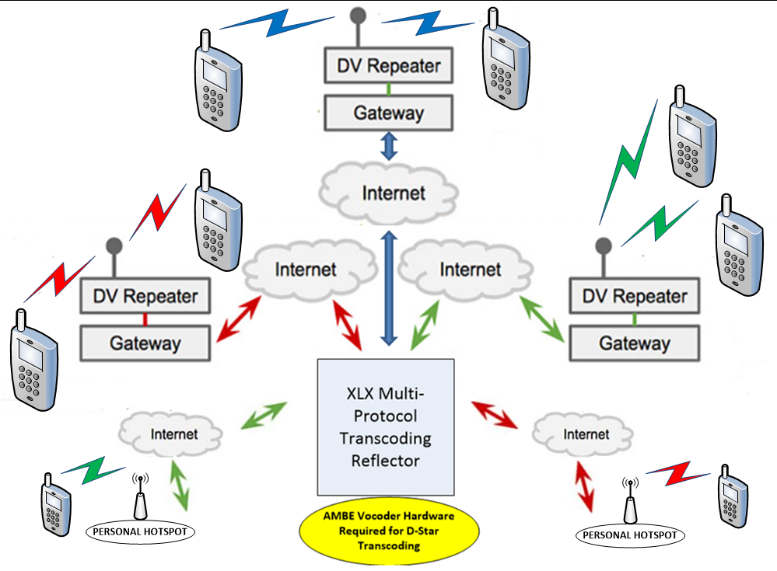
YSF
D-STAR
DMR
DMR
D-STAR

Slide 15
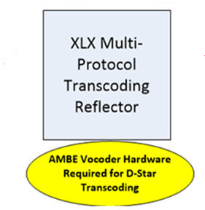
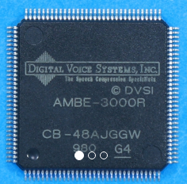
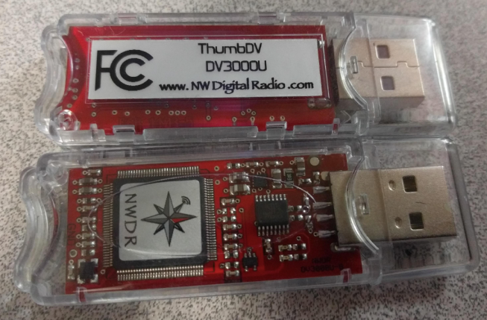
When XLX multi-protocol reflectors are called to transcode between D-Star the other DV modes like DMR, YSF or NXDN, this is not handled well with software along. This requires at least two hardware AMBE3000 vocoding chip mounted in a USB Stick. More may be required depending the traffic loading involving D-Star transcoding with other modes on other “modules” of the reflector. This can add significantly to the cost of implementing a XLX Reflector. If the reflector is installed as a rented VM space in a Cloud based server farm, then the USB AMBE vocoder stick can be installed on a stand alone server somewhere else where there is physical access to plug in the hardware. Transcoding between YSF and DMR or NXDN is solely handled with software and the D-Star AMBE vocoder chip doesn’t come into play.

Slide 16
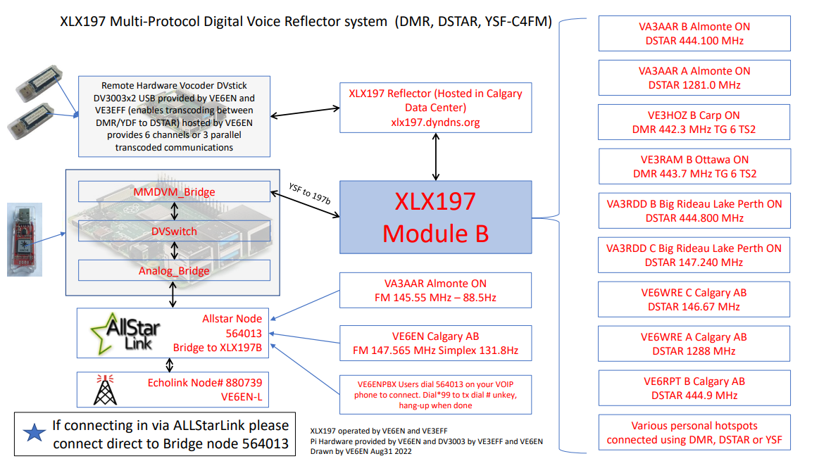
XLX 197 Reflector System Diagram
Operated by Andrew VE6EN and Jeff VE3EFF
Dashboard available at: https://xlx197.dyndns.org/

Slide 17
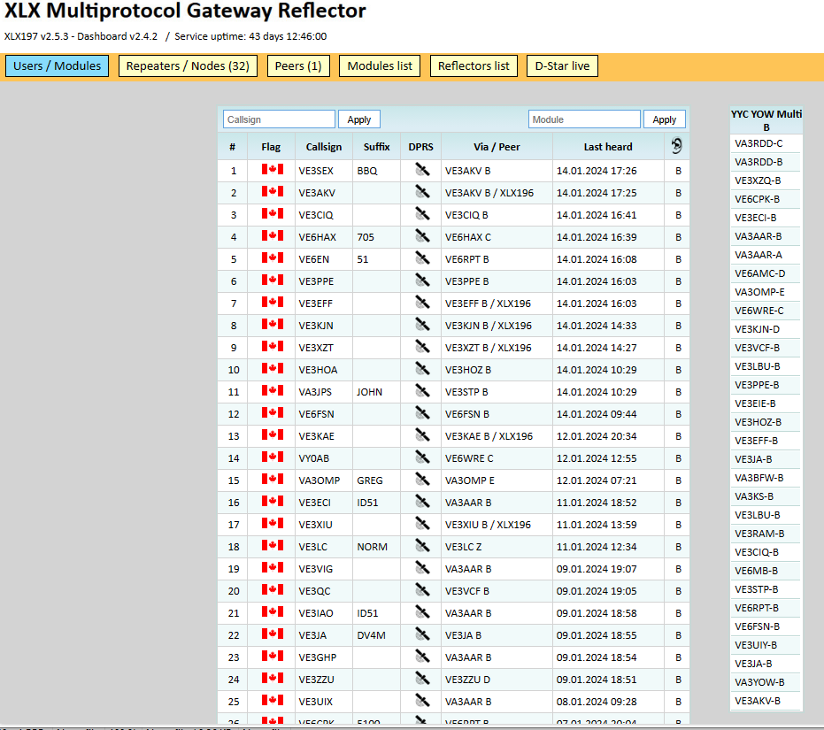

Slide 18
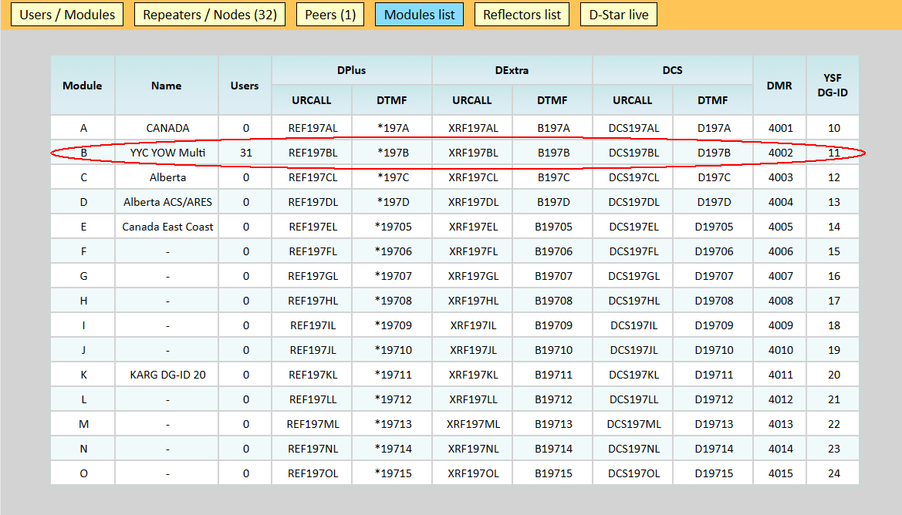
Module List of XLX197 Reflector
There are 15 modules (separate user conferences (A to O)
Module B is being used as a common channel of communications for the Ottawa area Calgary

Slide 19
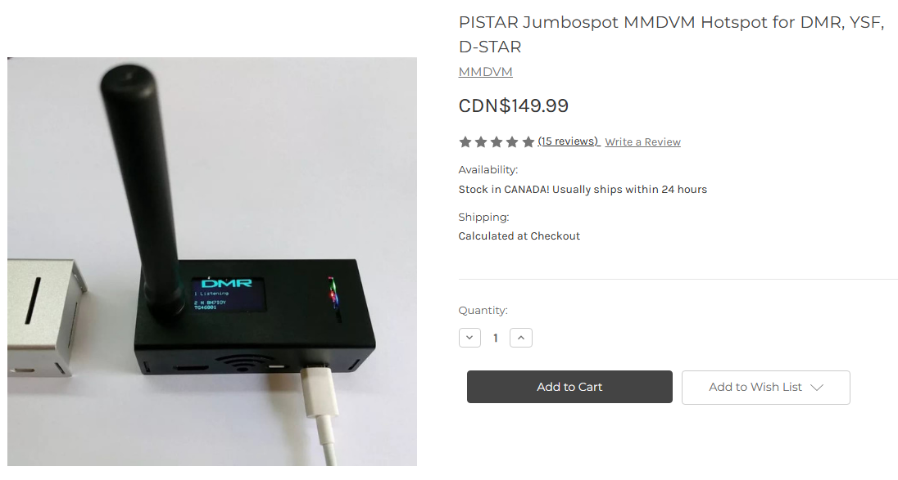
Hot Spots Lots to choose from:
From DxCanada.ca
Or from
Amazon.ca
and build
your own

Slide 20
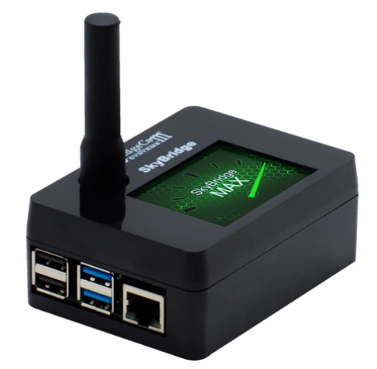
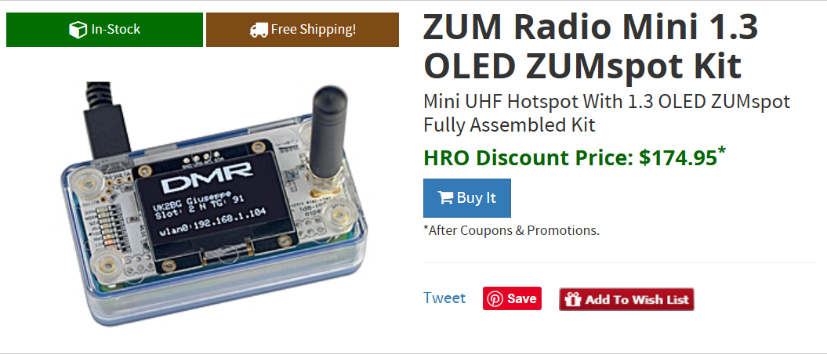
Works for DSTAR, DMR, Fusion, NXDN, P25, M17, Cross-Mode.

Slide 21
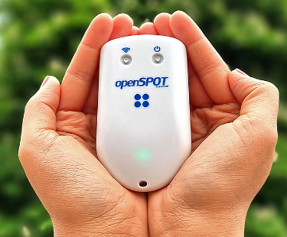
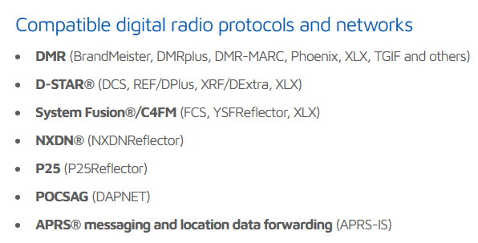
Open Spot 4
Any DV radio, D-Star, DMR, Yaesu
WiFi connectivity
Battery operated
Any system access
The Open Spot Pro has a hardware AMBE vocoder to transcode any other radio for access to D-Star only systems.

Slide 22
Multi-Mode Digital Voice Internet Gateway Software that runs on a Raspberry Pi for Repeaters and Personal Hot Spots
https://www.pistar.uk/

Slide 23
Status of Digital Repeaters in the Area:
VA3ODG (Ottawa Digital Group)
This was a premier D-Star system through the initiative of Rick Bandla VE3CVG back in 2007. Unfortunately, Rick became a silent key 2 years ago and since that time all equipment had to be removed from the YMCA on Argyle Street because of the sale of the premises. Originally this system was based on the complete ICOM “stack” of repeater and networking equipment providing 4 service modules:
module A (23 cm)
module B (70 cm)
module C (2 m) and
module D ( (high speed data on 23 cm).
VA3ODG was initially a local registration authority for the US Trust system but later became unaffiliated with this system and converted to gateway access using MMDVM Pi-Star.
The VA3ODG web site is still on-line at: https://va3odg.webqth.com/

Slide 24
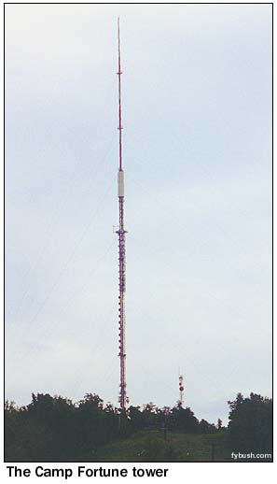
Ottawa Amateur Radio Club DMR Repeater
VE2CRA 444.400 MHz + 5 MHz, CC1 (Camp Fortune Site)
Suggested local use: Time Slot 2, TG 2
This repeater is a Pi-Star MMDVM machine enabled on DMR. It is on-the-air and provides good city wide coverage however it does not have an active Internet network connection at the present time. As a DMR repeater, it can repeater local traffic on either Time Slot or TG\ Group as Users may want to conduct mutual communications on.

Slide 25
Status of Digital Repeaters in the Area (continue):
VA3AAR (Almonte)
D-Star module A, 1281.00 MHz – 12 MHz linked to XLX197B
D-Star module B, 444.100 MHz+5 MHz linked to XLX197B
Dashboard: http://va3aar.dyndns.org:3026/
VA3RRD (Rideau Ferry) 147.240 – 600 kHz (module C)
D-Star - linked to XLX197B
VE3STP (Mount St Patrick) 443.600 MHz + 5 (module B)
D-Star 1- linked to XLX197B
Dashboard: http://ve3stp.ddns.net:44480/
VE3HOZ (Carp) 442.300 MHz + 5, DMR CC1
TS2 - TG6 static connection to XLX197B
TS1 – Brandmeister World-Wide system, > 1500 talk groups
Dashboard: http://ve3hoa.ddns.net:380/
VE3TST (CFRA AM radio site) antenna on North Tower
DMR on 444.125 MHz + 5, CC13, This is an un-networked repeater with Affiliation to the 3730 Group. Contact club exec to use. https://3730group.ca/

Slide 26
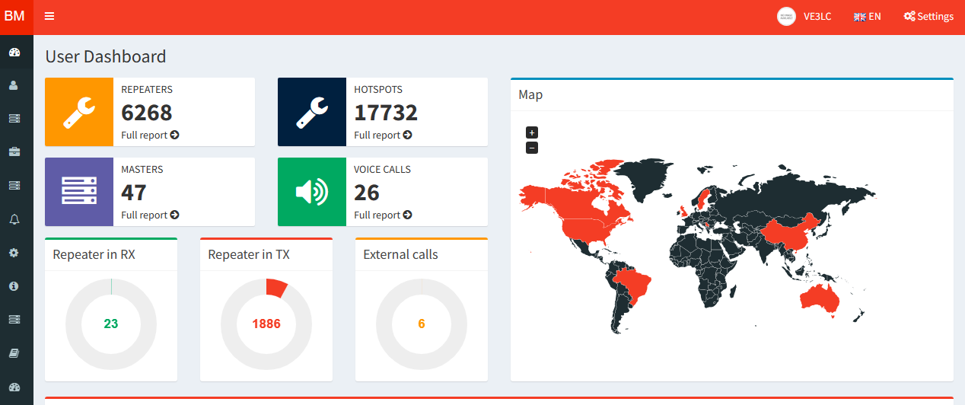
VE3RAM (B) (Orleans) 443.700 MHz + 5, DMR CC1
(at the QTH of VE3LC)
TS2 - TG6 static connection to XLX197B
TS1 – Brandmeister World-Wide system> 1500 talk groups
** USE Time Slot 1 for Brandmeister TG traffic**
D-Star Open to users connecting XLX type reflectors
The repeater has good coverage in Orleans with marginal coverage in surrounding area.
Brandmeister Home Page
Check out the Brandmeister Web Site: https://brandmeister.network/
Also: https://wiki.brandmeister.network/index.php/Canada

Slide 27
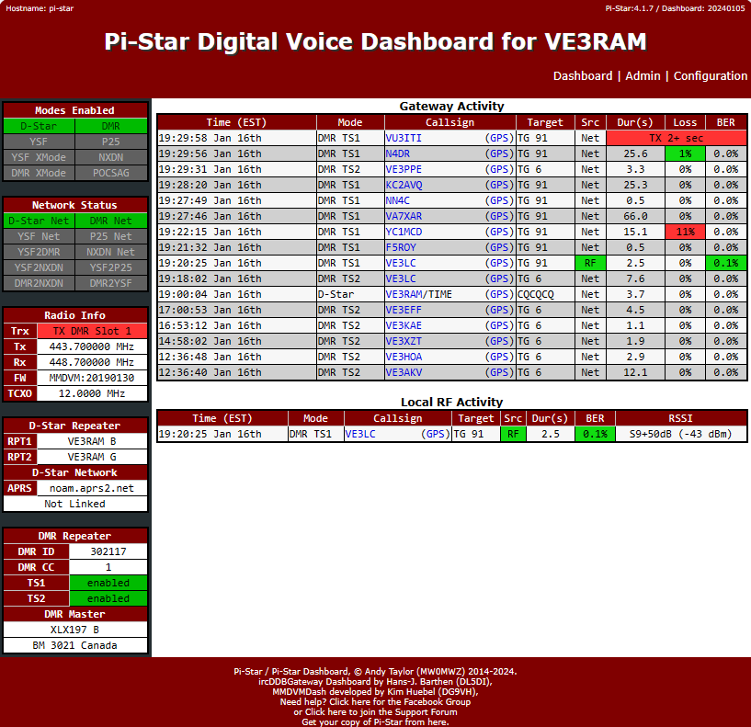
VE3RAM Pi-Star Dashboard
http://ve3ram.ddns.net:380/

Slide 28
VE3TWO 147.300 + 600 (100 Hz for FM)
This is a Yaesu Fusion Repeater capable of Digital C4FM and D-Star
Currently at the QTH of Marc VE3BOE
Marc through his Wires X node engages the VE3TWO on Wednesday evenings for the CQ-Canada (X-Canada) net conducted at 9 pm Eastern Time.
For VE3TWO, we plan to attach a Pi-Star gateway system that will provide access to the XLX197 reflector. This will give Yaesu Fusion and radio users access to much more local activity through reflector access.

Slide 29
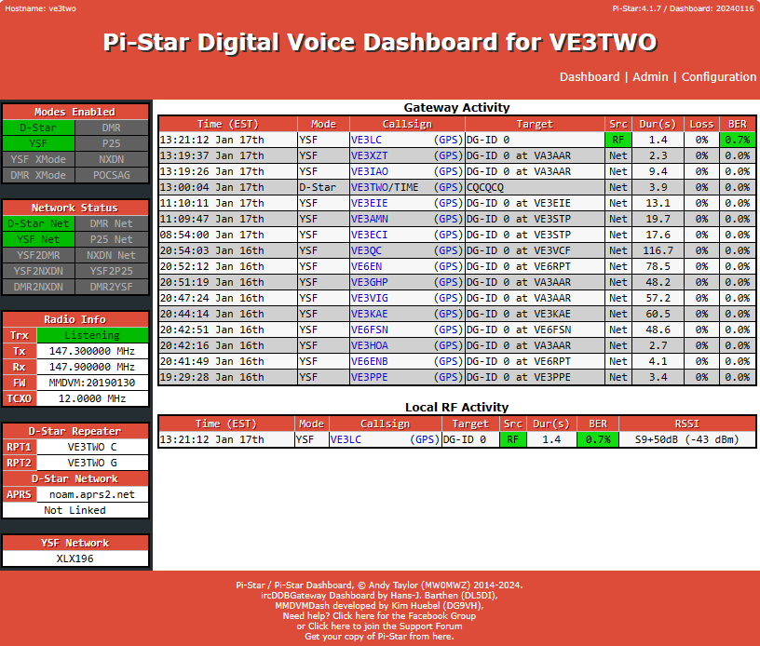

Slide 30
Digital Repeaters Across the River
Check out the following Links:
Club de Radio Amateur Outaouais Inc. https://ve2cro.ca/
Associations des Radio Amateurs Indépendants https://ve2reh.com/wp/
The End for Now..
Q & A

