Slide 1
OVMRC Allstar Link Hub
Adam VA3IRD

Slide 2
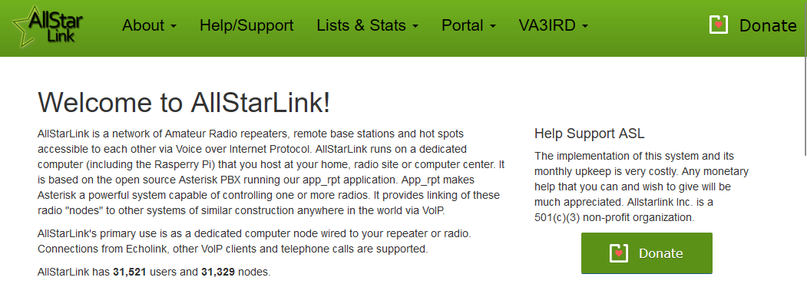
What is Allstar link?
“AllStarLink is a network of Amateur Radio repeaters, remote base stations and hot spots accessible to each other via Voice over Internet Protocol. AllStarLink runs on a dedicated computer (including the Rasperry Pi) that you host at your home, radio site or computer center. It is based on the open source Asterisk PBX running our app_rpt application. App_rpt makes Asterisk a powerful system capable of controlling one or more radios. It provides linking of these radio "nodes" to other systems of similar construction anywhere in the world via VoIP”
https://www.allstarlink.org/

Slide 3
IRLP/Echolink/Allstar?
IRLP | Echolink | Allstar
https://www.irlp.net/ | https://www.echolink.org/ | https://www.allstarlink.org/
Linux based, closed source | Windows client, Closed source | Linux, Open source - Asterisk PBX
Proprietary hardware | Some commercial hardware, some DIY configs | Kits, DIY interfaces, many configurations!
Repeater-Repeater | Computer and mobile phone software clients, repeaters | Node-node (hotspot, repeater, radioless node, radioless hub)

Slide 4
Allstar Hardware interfaces and clients
Type | Name | Link
Hardware interface | “Shari” Node (hotspot) | https://kits4hams.com/shari-pizero
Hardware interface | “DINAH” – DIN connector | https://kits4hams.com/dinah
Software client | DVSwitch Mobile | https://play.google.com/store/apps/details?id=org.dvswitch&hl=en_CA&gl=US
Bridge | Echolink enabled allstar node | https://www.echolink.org/
Bridge | Hamshack-Hotline enabled allstar node | https://apps.hamshackhotline.com/links.php

Slide 5
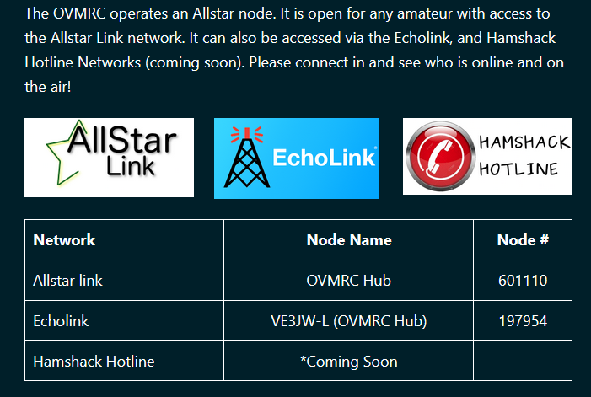
OVMRC Hub
Radioless hub node running on a hosted VPS
Backwards-compatible with Echolink
Accessible from Hamshack hotline 94089 (coming soon)
Can be connected to future club repeater deployments.
Could be a future pale to host nets and events
Status Dashboards
http://ovmrcashub.duckdns.org/supermon/link.php?nodes=601110
http://stats.allstarlink.org/stats/601110

Slide 6
Accessibility
Works with traditional 2m FM hardware
Uses inexpensive hobbyist hardware
Scalable – can run on a pi (ARM), or servers (AMD64)
Open source hardware
Interoperability
Great way to reutilize old hardware
New hardware and software being developed all the time!

