Slide 1
ISED Policy on Amateur Radio Call Signs RAC Proposals for change
Background:
April 2022 – CARAB: RAC told ISED that RIC-9 is due for an update
August-September 2022 – RAC Survey
2,315 responses from every province and territory (ca. 3%)
October 2022 – Raw data and analysis of the results: www.rac.ca
March2023 – First resolution adopted by RAC Board
May 2023 – Second resolution on C.. and X.. prefixes
June 2023 – Presentation to ISED at CARAB

Slide 2
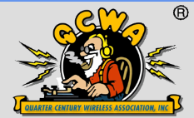
ISED Policy on Amateur Radio Call Signs RAC Proposals for change
Current policy:
- Call signs are allocated until you turn 125
- Consequences: Ghost Hams, unused call signs are artificially unavailable
Proposal:
- Renew registration of call signs every five years
Method: log in to the ISED website
- After five years with no contact: suspend call
- After six years with no contact: re-issue call
- Those aged 75 or older: optional paper renewal
QuasquiCentennial Wireless Association?
Renewal of the registration of call signs:
The registration of regular-issue call signs for individual Amateurs and Amateur Radio Club stations be subject to a periodic renewal. RAC recommends a renewal period not exceeding five (5) years. Renewals should normally be by individual Radio Amateurs and trustees of Club stations logging in to the ISED website. Each login renews the registration for a further five (5) years.
If more than five years lapses since the most recent renewal, ISED will suspend the registration of that call sign for a period of one year. This will allow the holder of a lapsed call sign to recover that call sign. After six years elapses since the most recent renewal, that call sign may be made available for registration to any qualified individual or club.
Persons aged seventy-five (75) or older should be allowed to renew the registration of their call signs by mail or some similar paper process.

Slide 3
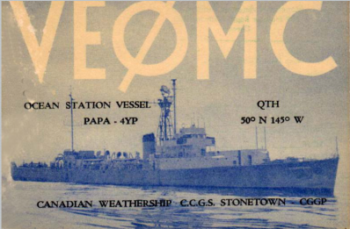
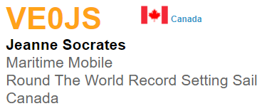
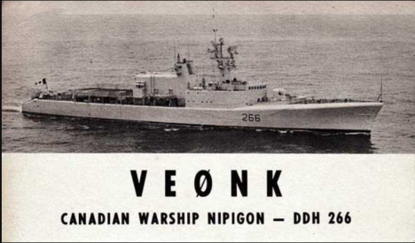
RAC Proposal: VEØ – add space
Authorise VEØ call signs for:
Canadian Amateur Satellites
Canadian Astronauts on space missions
Club stations on the ISS or similar
Fix the text:
Clarify that VEØ call signs may only be used on ships outside Canadian waters or in space
Expansion of the use of VEØ call signs:
VEØ call signs should also be authorized for use as identifiers for Canadian Amateur Radio Satellites, Canadian astronauts while on missions in space, and as club stations aboard the International Space Station or similar permanent missions in space.
The language describing the use of the VEØ call signs should be clarified to make clear that VEØ call signs may only be used on water vessels outside Canadian territorial waters and in space.

Slide 4
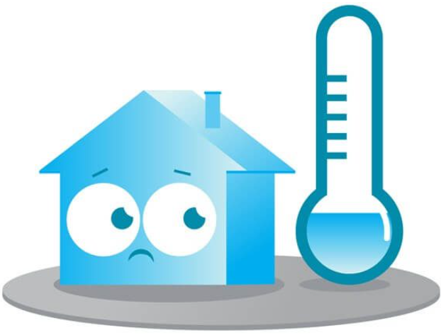
RAC Proposal – “cooling-off” period
If a call sign has been surrendered:
After a year, it can be made available to any qualified individual or club
“Cooling-off” period following the surrender of a call sign:
In cases where a call sign has been surrendered by an individual or a club, that call sign should be withheld from re-issue for a period of one (1) year, after which it may be made available for re-issue to any qualified individual or club.

Slide 5
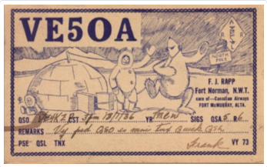
RAC Proposal – Two-Letter Calls
Ex: VE1AA
Current policy:
Five Years experience
Exceptions Labrador, NB, PE, NU, NT, YT
Proposal:
Available to individuals who are:
Holders of an Advanced certificate, and
Have held a Canadian certificate for ten years
Abolish the exception for new Amateurs in VE8, VE9, VO2, VYØ, VY1 and VY2 to hold two-letter call signs
“Two-Letter” Call Signs:
An individual seeking to be issued a call sign with a two-letter suffix (ie., VE1AA) must hold a Canadian Amateur certificate for no less than ten (10) years and hold the Advanced qualification.
This qualification should be applied in every call area of Canada without the current exemption for those areas which have small Amateur populations. The current areas with that exemption are: Northwest Territories (VE8), New Brunswick (VE9), Labrador (VO2), Nunavut (VYØ), Yukon (VY1) and Prince Edward Island (VY2).
The effect of this change would require all newly-certified Radio Amateus in Canada to be issued with three-letter suffixed call signs (ie., VE1AAA).
The only exception would be for persons seeking acquire the two-letter call sign of a recently-deceased close relative. The ten (10) year qualification would not apply in these cases, but the requirement to hold an Advanced qualification would apply.

Slide 6
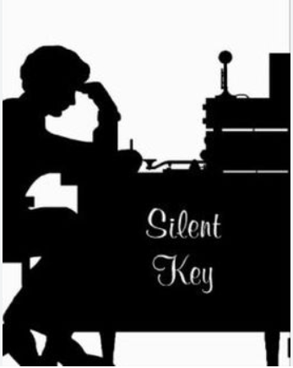
RAC Proposal – “Silent keys”
Exception:
Maintain the preferred access for family members to obtain the call of a silent key
To gain the two-letter call of a deceased relative, one would have to hold an Advanced certificate
The proposed “10 year” qualification would not apply.
“Silent Keys” – Deceased Radio Amateurs’ call signs:
RAC supports continuing the policy of allowing qualified immediate family members of a deceased Radio Amateur to acquire that Radio Amateur’s call sign. However, RAC requests that a family member who seeks to acquire a “two-letter” call sign of a deceased relative must have the Advanced qualification.
RAC supports the current ISED practice of allowing qualfified immediate family members to acquire the call signs of deceased relatives within one (1) year of the passing of that person. When one (1) year has elapsed since the death of a Radio Amateur, that person’s call signs may be made available for re-issue to any qualified Radio Amateur.

Slide 7
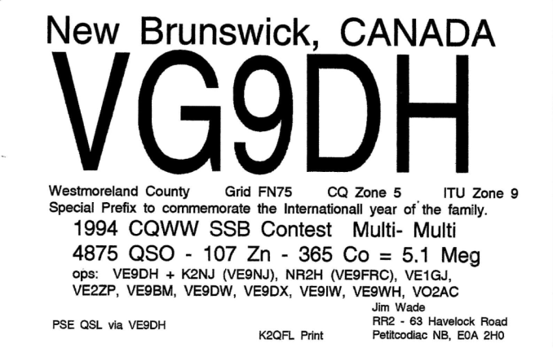
RAC Proposal: Special Prefixes
Change current policy on Special Prefixes:
For every regular prefixes, set aside only TWO possible special prefixes:
For VAs: VB and VC
For VEs: VF and VG
For VO1s: VO3 and VO5
For VO2s: VO4 and VO6
For VYØs: VY7 and VY8
For VY1s: VY3 and VY5
For VY2s: VY4 and VY6
Authorisation period: up to 12 months, or the duration of the event, whichever is shorter.
VB prefixes: «stratgeic reserve» for future growth.
When VB-prefixed regular call signs begin to be issued, there will be only one special prefix available in the VA/VB/VE call areas:
For VAs: VC
For VBs: VF
For VEs: VG
Special Prefixes:
RAC supports the current policy of permitting Canadian Radio Amateurs to use special prefixes. RAC, however suggests that the number of possible prefixes authorized in each call area be limited to two (2);
Stations with VA call signs may be authorized to use the prefixes VB or VC;
Stations with VE call signs may be authorized to use the prefixes VF or VG;
Stations with VO1 call signs may be authorized to use the prefixes VO3 or VO5;
Stations with VO2 call signs may be authorized to use the prefixes VO4 or VO8;
Stations with VYØ call signs may be authorized to use the prefixes VY7 or VY8;
Stations with VY1 call signs may be authorized to use the prefixes VY3 or VY5;
Stations with VY2 call signs me be authorized to use the prefixes VY4 or VY6.
The maximum period for which special prefixes may be authorized should be changed from the current two (2) months to “twelve (12) months or the duration of the event being commemorated, whichever is less.”
When the supply of VA and VE call signs approaches exhaustion in any call area, the VB and VF prefixes should be withdrawn as special prefixes for VA and VE call signs. VB will then become an additional regular prefix in the VE call areas and permanent two-letter and three-letter call signs authorized for issue in the VA and VE call areas. From that point, special prefixes may be authorized as follows:
Stations with VA call signs may be authorized to use the prefix VB;
Stations with VB call signs may be authorized to use the prefix VF;
Stations with VE call signs may be authorized to use the prefix VG;
Stations with VO1 call signs may be authorized to use the prefixes VO3 or VO5;
Stations with VO2 call signs may be authorized to use the prefixes VO4 or VO8;
Stations with VYØ call signs may be authorized to use the prefixes VY7 or VY8;
Stations with VY1 call signs may be authorized to use the prefixes VY3 or VY5;
Stations with VY2 call signs me be authorized to use the prefixes VY4 or VY6.
NOTE: When regular call signs with the VB prefix begin to be issued, Amateurs in call areas where VA, VB and VE prefixed call signs are issued will have only one alternative special prefix.

Slide 8
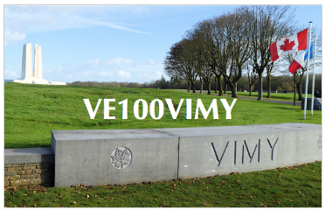
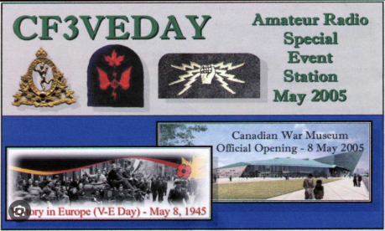
RAC Proposal: Special Event Calls
Call Signs for Special Event Stations:
VD and VX exclusively
The numeral will have no geographic significance
Format:
Two letters (VD or VX)
Followed by a numeral
Followed by a combination of numerals and letters
Ending in a letter:
Minimum four (4) characters
Maximum eleven (11) characters
ex: VDØA – shortest
ex: VX2023CIR9M – longest
Maximum duration:
12 months or the duration of the event being celebrated, whichever is less
Special Event Call Signs:
Unusual-format call signs may be authorized using the VD and VX prefixes only for the purpose of marking a special event or an anniversary.
Special Event Call Signs will be in the following format:
Beginning with the letters “VD” or “VX,” signifying Canada.
Followed by a numeral from Ø to 9. The numeral will have no geographic significance and will not necessarily correlate with any existing call areas.
Followed by a group of one (1) to eight (8) letters or numerals, the last of which shall be a letter.
Examples:
The shortest such call sign would be four (4) characters long and could be in the format “VDØA.”
The longest such call sign would be eleven (11) characters long and could be in the format “VX2023RIC9U.”
Such call signs may be authorized on a temporary basis to mark a special event or anniversary.
Such call signs may be authorized for any location in Canada.
The maximum period for which a special event call sign may be authorized should be changed from the current two (2) months to “twelve (12) months or the duration of the event being commemorated, whichever is less.”

Slide 9
RAC Proposal: Entry-Level
Entry-level certificate proposed by RAC in 2022:
Three years
Not renewable
Limited frequency and power privileges
Distinctive call signs
Call signs proposal:
VAØ followed by three letters
Issued in strict alphabetical order
The numeral has no geographic significance
On expiry, the call becomes available for re-issue to a new entry-level certificate holder
Distinctive Prefix for Proposed Entry-Level Certificate:
RAC has proposed to ISED the creation of a new entry-level Amateur Radio certificate. The general features of this proposal are that such certificates would expire after three (3) years with no possibility of renewal. Such a certificate, allow limited frequency and power privileges. Holders would be issued a call sign from a distinct series.
RAC recommends that the VAØAAA to VAØZZZ series of call signs be set aside for this purpose. The “Ø” in the call sign will have no geographic significance and a VAØxxx call sign could be registered to an address anywhere in Canada.
VAØxxx call signs will be issued in strict alphabetical order. Holders will not have the option to choose the suffix of their call signs.
Once the Entry-Level certificate holder’s three (3) year authorization has expired, their call sign will be suspended for one (1) year and made available for re-issue to a future Entry-Level certificate holder.

Slide 10
RAC Proposal: Guidance on acceptable modifications to call signs
RAC requests the publication of optional “special suffixes”
/P - portable
/M - mobile
/MM – “maritime mobile”
/AM – “aeronautical mobile”
/R – “Rover” – VHF contests
/VE1 – in another region
/### - to mark an event
Ex: VE3QCW/3Ø for RAC’s 30th anniversary
Voluntary Modifications to Call Signs:
RAC recommends that ISED publish guidance indicating that Canadian Radio Amateurs using Canadian Call Signs may modify their call signs by the addition of certain suffixes. This proposal reflects current good Amateur practice and will mirror similar statements in the Amateur Radio regulations and policies of many other countries. This will serve to provide clarity to Amateurs who may be unsure of these practices.
The proposed guidance should indicate the following:
Special Suffixes: At their option, Radio Amateurs using Canadian call signs may modify their call signs by adding the following suffixes:
“/P” or using the word “portable” when operating from a temporary location away from their registered address
“/M” or using the word “mobile” when operating a mobile station on land
“/MM” or using the words “marine mobile” or “maritime mobile” when operating aboard a water vessel, either inside or outside Canadian territorial waters
“/AM” or using the words “aeronautical mobile” when operating aboard an aircraft
“/R” or “Rover” to indicate the operator is changing locations frequently, a practice used in some Amateur Radio contests above 50 MHz
“/VE1” or “portable VE1” (example) when operating a portable or mobile station and they wish to indicate in which call area they are located. The correct practice is to use the VE1-9, VO1-2, VYØ-1-2 call area prefix associated with the area in which they are located. In this example, adding “/VE1” or “portable VE1” is used to indicate the operator is in Nova Scotia.
“/###” or “stroke” followed by one or more numerals, used to indicate an activity of some significance, such as an anniversary of a radio club or some public event.
This guidance should state that none of these are regulatory requirements, but they represent the most commonly-used acceptable methods of modifying one’s call sign in the Amateur Service.

Slide 11
Pending resolution: New two-letter call signs
New two-letter call signs using the CF, CG, CH, CI, CJ, CK, CY, CZ, XJ, XK, XL, XM and XO prefixes
Ex: CF1AA, XOØZZ
Available to individuals only
Max: 1 per person
Qualification:
Advanced + 10 years as a Canadian Amateur
The numeral would have no geographic significance,
One could move and keep your call sign
CY9 and CYØ: Reserved for St Paul and Sable
Exclusively for Newfoundland and Labrador:
VO7, VO8, VO9, VOØ
New Two-Letter and One-Letter Suffixed call signs:
RAC requests that ISED authorize two new series of call signs.
New “Two-Letter” call signs using the C.. and X.. prefixes allocated to Canada by the ITU. An example of such a call sign would be “CF1AA.”
Such call signs would not be available for issue to clubs. These call signs would be available only to individuals holding an Advanced certificate and with ten years as a Canadian Radio Amateur
“Two-Letter” call signs may be issued using the CF, CG, CH, CI, CJ, CK, CY, CZ, XJ, XK, XL, XM and XO prefixes.
Call signs with C.. and X.. prefixes may be registered to an address anywhere in Canada. The numeral will have no geographic significance. Holders of such C.. and X.. call signs will not be required to change them when moving to a new province, territory or region. EXCEPTION: CY9 and CYØ call signs will only be authorized for temporary operations from St Paul Island and Sable Island, which are part of Nova Scotia.
Additionally, Two-Letter suffixed call signs may be issued to individuals with the VO7, VO8, VO9, VOØ, VY3, VY4, VY5, VY6, VY7 and VY8 prefixes for Radio Amateurs in Newfoundland and Labrador, Nunavut, Yukon and Prince Edward Island, respectively.

Slide 12
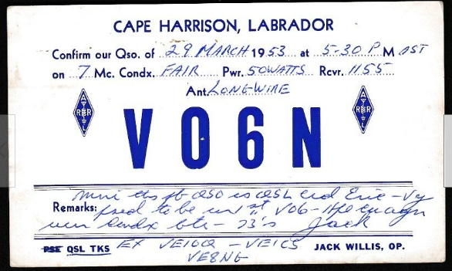
Pending resolution: New one-letter call signs
New one-letter call signs using the CF, CG, CH, CI, CJ, CK, CY, CZ, XJ, XK, XL, XM and XO prefixes
ex: CF1A, XOØZ
Available to individuals only
Max: 1 per person
Qualification:
Advanced + Morse Code + 10 years as a Canadian Amateur
The numeral would have no geographic significance,
One could move and keep your call sign
CY9 and CYØ: Reserved for St Paul and Sable
Exclusively for Newfoundland and Labrador:
VO7, VO8, VO9, VOØ
Exclusively for Nunavut, Yukon and PEI:
VY3, VY4, VY5, VY6, VY7 et VY8
New “One-Letter” call signs using the C.. and X.. prefixes allocated to Canada by the ITU. An example of a call sign would be “XJ1A.”
Such call signs would not be available for issue to clubs. These call signs would be available only to individuals.
To qualify for a One-Letter suffixed call sign, the individual must hold have held a Canadian Amateur Radio certificate for at least ten (10) years and must hold an Advanced and Morse Code qualifications.
“One-Letter” call signs will not be issued with any of the traditional prefixes of VA#, VE#, VO1, VO2, VYØ, VY1 or VY2.
“One-Letter” call signs may be issued using the CF, CG, CH, CI, CJ, CK, CY, CZ, XJ, XK, XL, XM and XO prefixes. Additionally, One-Letter suffixed call signs may be issued to individuals with the VO7, VO8, VO9, VOØ, VY3, VY4, VY5, VY6, VY7 and VY8 prefixes for Radio Amateurs in Newfoundland and Labrador, Nunavut, Yukon and Prince Edward Island, respectively.
An individual may hold only one call sign in any two-letter format and only one call sign in any one-letter format.
Amateurs using call signs in these formats will not have Special Prefix alternatives to mark special events.

Slide 13
Summary
CF-CZ: format CF1A, CF1AA:
Anywhere in Canada,
CY9, CYØ: St-Paul Island and Sable Island
Advanced + 10 years (+ Morse)
VA: Format VA1AA, VA1AAA
Conforms to current call areas
VAØ – new “entry level” certificate
VB*, VC: special prefixes for VAs
Conforms to current call areas
*strategic reserve for growth
VD: Special event stations
Flexible format, no geographic significance
VE: Format VE1AA, VE1AAA
Conforms to current call areas
VEØ: ships, space
VF*, VG: special prefixes for VEs
*strategic reserve for growth
VO1, VO2: format: VO1AA, VO2AAA
Conforms to current call areas
VO3-VO4-VO5-VO6: special prefixes for VO1/VO2 odd/even
VO7-VO8-VO9-VOØ: format: VO7A, VO8AA only in NL, odd/even
Advanced + 10 years (+ Morse)
VX: Special event stations
Flexible format, no geographic significance
Exclusion for VX9aa, VX9aaa
VYØ-VY1-VY2: format VYØAA, VY1AAA
Conforms to current call areas
VY3, VY5: special prefixes for VY1
+ 2x1s for Adv+Morse+10yrs
VY4, VY6: special prefixes for VY2
+ 2x1s for Adv+Morse+10yrs
VY7, VY8: special prefixes for VYØ
+ 2x1s for Adv+Morse+10yrs
VY9: Stations of the Government of Canada
XJ-XO: Format XJ1A, XJ1AA:
Anywhere in Canada,
Advanced + 10 years (+ Morse)

Slide 14
If implemented by ISED, these proposals would:
protect the current VA, VE, VO and VY call areas
expand the use of all Canadian prefixes
make fuller use of the historically significant VO prefixes
reinforce the special character of the VO and VY call areas
Reinforce the exclusivity of the CY9 and CYØ prefixes
allow for mobility of call signs for those who move
ISED on call areas: administrative burden, serve no regulatory purpose
permanently eliminate the shortage of two-letter call signs
respond to a significant demand for one-letter call signs
make easier translation of special prefixes to regular call signs
allow better choices for Special Event Station call signs
provide incentives for Amateurs to upgrade their skills, knowledge and qualifications
bring Canadian practices in line with ITU regulations and practices in many countries
provide a policy that may not require revision for many decades
take away nothing from anyone

